Slide 1
What is it?
Student: Do Dung Vu
Supervised by: Prof. Sylvie Ratté and Dr. Ronald Brisebois

Slide 2
Outline
Motivation
Artificial intelligence (AI) forecast
AI virtual assistance
Literature review
Challenges
Objectives
Methodology
Study Plan
Question

Slide 3
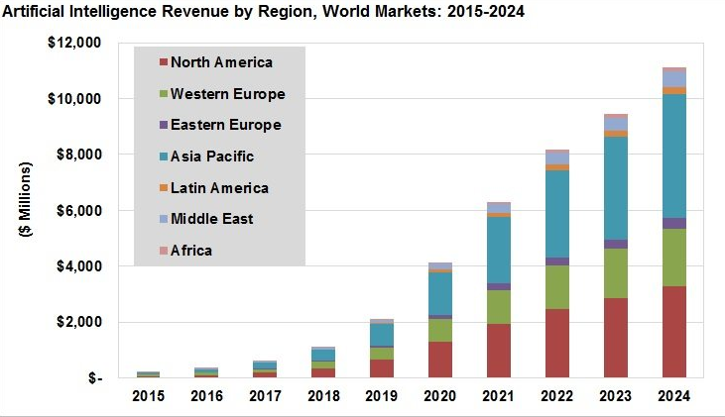
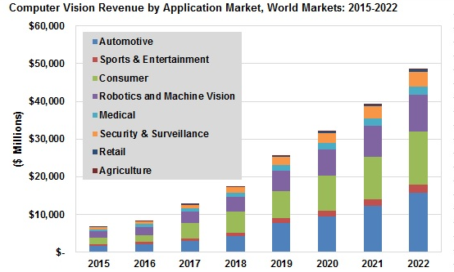
Artificial intelligence (AI) forecast
Source: Tractica

Slide 4

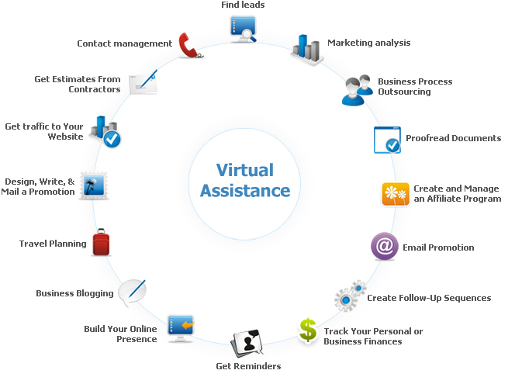

AI virtual assistants
- Could you explain and show me more information of the new items which I have not seen yet?
Source: http://www.cogniview.com

Slide 5
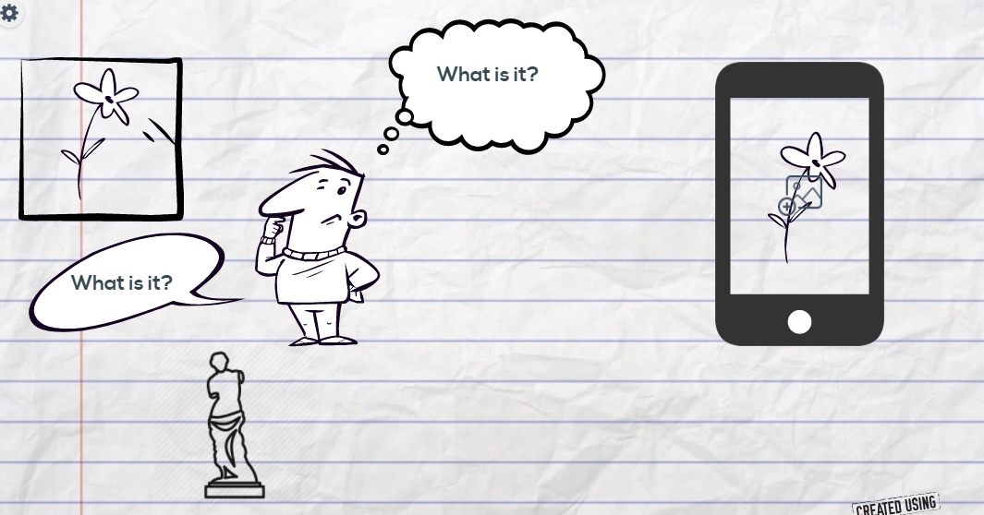








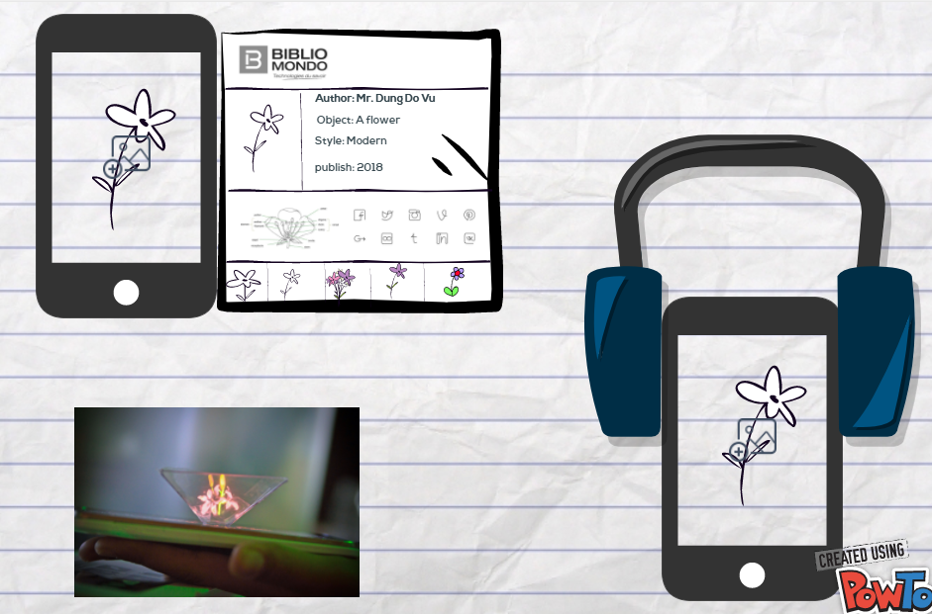

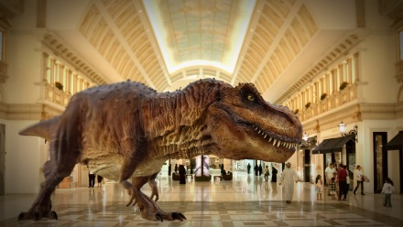
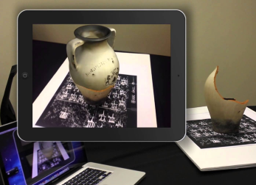
VIRTUAL REALITY
hologram
AUGMENTED REALITY

Slide 6








My phone 1
Museum 1
Bibliomondo
Museum 1
CLIENT
Detect and recognize object :
+ Recommendation system
+ Machine learning
+ Artificial Intelligence
+ Search engine algorithm
Verification:
+ Geo-location of the item
+ Bar-code of the item
User contribution:
+ User may catelogy manual
+ Vote the responded information
- Updated
------------------------------------
SERVER
+ Recommendation system
+ Reinforcement Learning
+ Machine learning
+ Artificial Intelligence
+ Search engine algorithm
Internet
Museum n
My phone n
Museum n

Slide 7
Literature review
Content based image retrieval (CBIR) is an important research area for manipulating large multimedia databases and digital library characterized by automatic indexing of images based on their own visual features, CBIR uses featured include [1] color, texture, shape, and edge information

Slide 8
Literature review
The features were classified using the random forest classifier and provided 74.7% accuracy for the RGB data[2]. Spare coding [3] and clustering based convolutional extractors [4],[5] have increased the classification performance to 85.2%
The visualizations in [6][7] indicates that, as the distribution of objects is transformed from overlapped space to separable space in a deep network, intermediate representations can be used as generic features to semantically describe the object in the input image

Slide 9
Literature review
[1] Naresh Babu, Pothlaiah, and Ashok Babu, “Image Retieval Color, Shape, and Texture Features using Content Based”, International Journal of Engineering Science and Technology, Vol. 2, No. 9, pp. 4278-4287, 2010
[2] K. Lai, L. Bo, X. Ren, and D. Fox, “A lage-scale hierarchical mulit-view RBG-D object dataset”, in Proc, IEEE Int. Conf. Robot. Autom. (ICRA), May 2011, pp. 1817-1824
[3] L. Bo X. Ren, and D. Fox, “Unsupervised feature learning for RBG-D based object recognition”, in Experimental Robotics, Springer, 2013, pp. 387-402
[4] R. Socher, B. Huval, B. Bath, C. D. Manning, and A. Y. Ng, “Convolutional-recursive deep learning for 3D object classification”, in Proc, Adv. Neural Inf. Process. Syst., 2012, pp. 665-673
[5] Y. Cheng, X. Xhao, K. Huang, and T. Tan, “Semi-supervised learning and feature evaluation for RGB-D object recognition”, Comput. Vis. Image Understand, vol. 139, pp. 149-160, Oct, 2015
[6] J.Donahue et al. (2013). DeCAF: A deep convolutional activation feature for generic visual recognition”, [Online]
[7] M. D. Zeiler and R. Fergus, “Visualizing and understanding convolutional networks”, in Computer Vision – ECCV. Springer, 2014, pp. 818-833

Slide 10
Challenges
Identify and recognize the object with the “private feature” of artwork, specimen
Faster handling of responding for real time used cases
Data authenticity, confidentiality, ready, and integrity for real time applications
Updating meta-data based on the collected information from each node ( user)

Slide 11
Objectives
Enhance privacy virtual assistance in Library and Museum
Improve the accuracy and performance of object recognizing to detect the “private feature” of each artwork, specimen in the museum, or person, car, furniture, the original of items, etc.,
Design automatically category mechanism for object recognition, and application development as well as for detecting “private feature” of each artwork and specimen
Develop algorithms and applications based on the given metadata of the library, museum, or open data

Slide 12
Methodology
Exploit the Artificial, Deep, Recurrent, Convolutional neural networks (ANN,DNN, RNN,CNN), Supervised, Unsupervised, and Deep reinforcement learning, search engine algorithm to improve the quality of object recognition.
Build-up machine learning algorithms and artificial intelligence in order to recognize, analyze and make the explanation of a given object by using smartphone camera.
Make the approximated verification method to confirm the accuracy of generated information

Slide 13
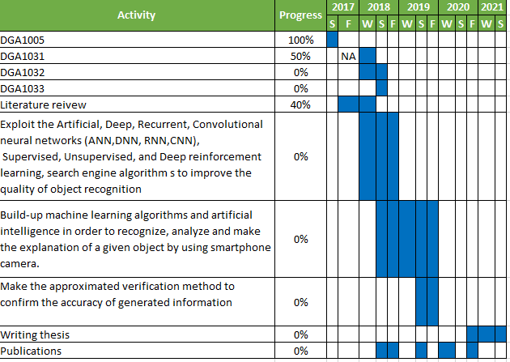
Study plan

